Slide 1
System Setup for SyNSlicerEngine

Slide 2
Contents
Installation of Visual Studio 2022
Installation of Git
Installation of CMake
Installation of vcpkg
Installation of Qt 6.3.0
Installation of CGAL 5.6
Installation of Boost 1.75.0
Installation of VTK9.3
Installation of Eigen3
Installation of Clipper2
Installation of spdlog
Check Environmental Variables
Build SyNSlicerEngine

Slide 3
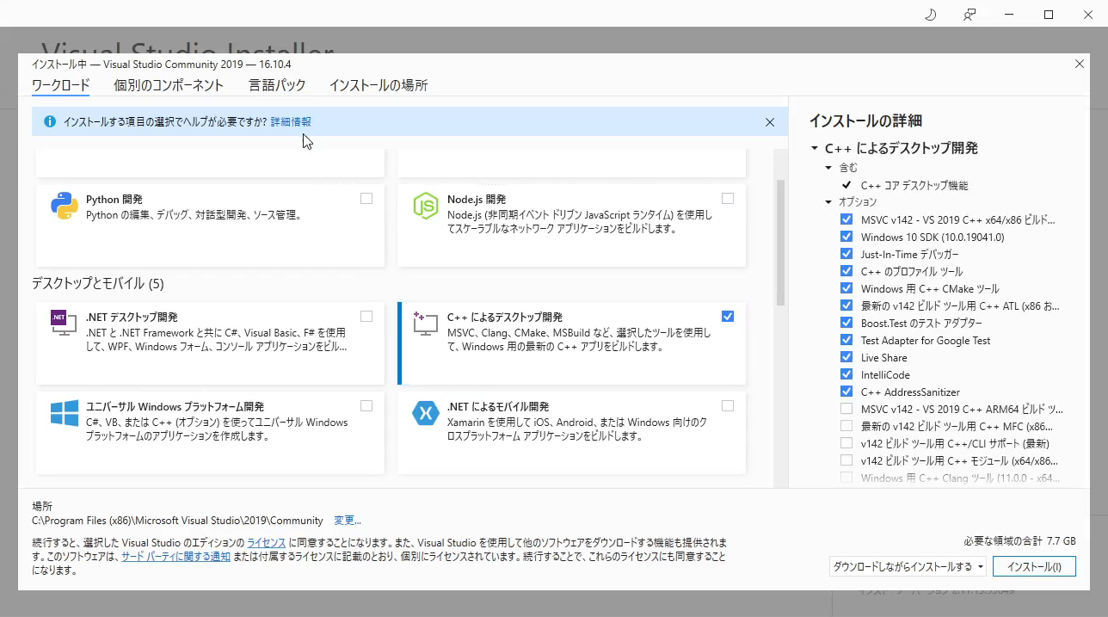
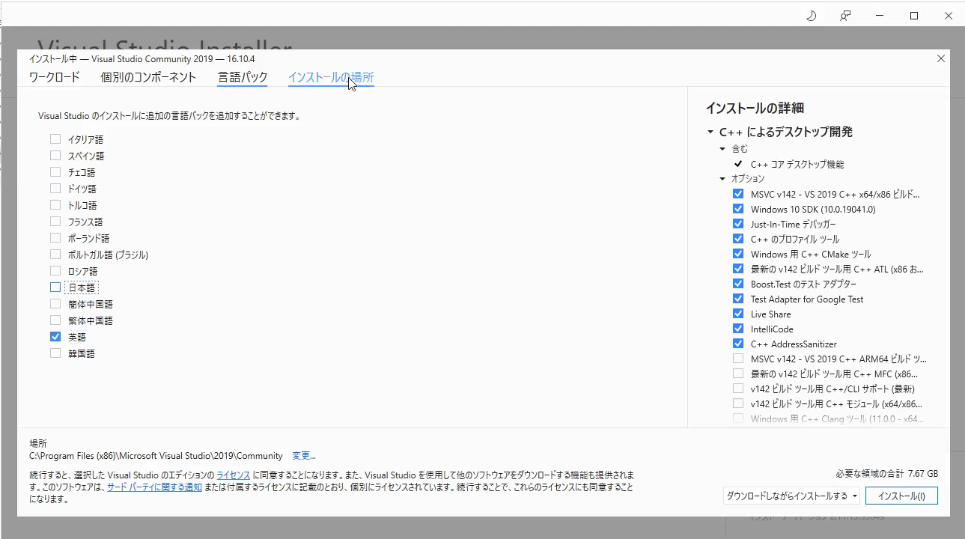
Installation of Visual Studio 2022
Link: https://visualstudio.microsoft.com/zh-hant/downloads/
Download Community Version(社群版)
Make sure the language pack is English!

Slide 4
Installation of Git
Link: https://git-scm.com/downloads
Download the latest version
Use default Setting for all options

Slide 5
Installation of CMake
Link: https://cmake.org/download/
Download the latest one
Using default settings

Slide 6
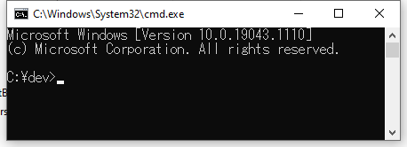
Installation of vcpkg
Create dev directory in C: drive
Open command window
Copy the following commands
git clone https://github.com/microsoft/vcpkg
cd vcpkg
.\bootstrap-vcpkg.bat
vcpkg integrate install
Set Environmental Variable
Add C:\dev\vcpkg\installed\x64-windows\bin to Path in system variable (Your computer may not use \ to separate the words, change \ based on your computer setting)

Slide 7
Installation of Qt 6.3.0
Link: Open Source Development | Open Source License | Qt
Run .exe
Set installation path to C:\dev\Library\Qt
Choose Qt 6.3.0 msvc 2019 64-bit
Set Environmental variables (Important! Otherwise, VTK cannot be installed)
Add C:\dev\Library\Qt\6.3.0\msvc2019_64 to QTDIR in system variable
Add %QTDIR%\bin to Path in system variable

Slide 8
Installation of CGAL
Link: Release CGAL 5.6 · CGAL/cgal (github.com)
Download CGAL-5.6-library.zip and GMP and MPFR libraries, for Windows 64bits
Extract CGAL-5.6-library.zip to C:\dev\Library
Extract CGAL-5.6-win64-auxiliary-libraries-gmp-mpfr.zip to C:\dev\Library\CGAL-5.2.1
Set Environmental variables
Add C:\dev\Library\CGAL-5.6 to CGAL_DIR in system variable

Slide 9
Installation of Boost 1.75.0
Link: Boost C++ Libraries - Browse /boost-binaries/1.75.0 at SourceForge.net
Run boost_1_75_0-msvc-14.2-64.exe, set install path to C:\dev\Library\boost_1_75_0
Set Environmental variables
Add C:\dev\libboost_1_75_0\lib64-msvc-14.2 to BOOST_LIBRARYDIR in system variable
Add C:\dev\libboost_1_75_0 to BOOST_INCLUDEDIR in system variable
Add C:\dev\libboost_1_75_0\lib64-msvc-14.2 to Path in system variable

Slide 10

Installation of VTK9.2.6
Download VTK-9.2.6.tar.gz in XUPENGDA-HKUST/SyNSlicerEngine (github.com)
Extract to C:\dev\Project
In C:\dev\Project\VTK-9.2.6, create a new folder call “build”
Run CMake.exe and step the paths, click Configure

Slide 11
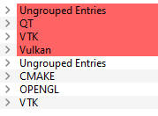

Installation of VTK9.2.6 (Con't)
Click both
Set VTK_GROUP_ENABLE_Qt to YES
Set CMAKE_INSTALL_PREFIX to C:/dev/Library/VTK_9.2.6_Debug
Click Configure again
QT appears, click Configure again and then click Generate
Click Open Project

Slide 12

Installation of VTK9.2.6 (Con't)
Mouse right click on ALL_BUILD and then click build
It will take sometimes.
Make sure no failed build.
Mouse right click on INSTALL and then click build
Set Environmental variables
Add C:\dev\Library\VTK_9.2.6_Debug to VTK_DIR in system variable
Add %VTK_DIR%\bin to Path in system variable

Slide 13
Installation of Eigen3
Run cmd in C:\dev\Library\vcpkg
Run command vcpkg install eigen3:x64-windows
Add C:\dev\Library\vcpkg\packages\eigen3_x64-windows to Eigen3_DIR in system variable

Slide 14
Installation of Clipper2
Link: Release Clipper2 ver. 1.3.0 · AngusJohnson/Clipper2 (github.com)
Create a folder called Clipper2 in C:\dev\Library
Extract the all the contents in the downloaded zip file to C:\dev\Library\Clipper2
Add C:\dev\Library\Clipper2 to CLIPPER2_DIR in system variable

Slide 15
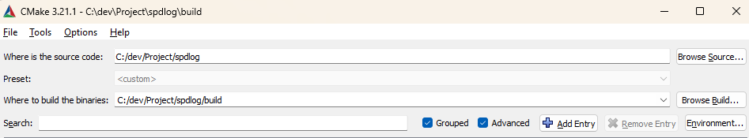
Installation of spdlog
Run cmd.exe in C:\dev\Project
Input git clone https://github.com/gabime/spdlog.git and then cd spdlog && mkdir build && cd build
Run CMake.exe, set path shown in red box and then click Configure, then click Finish

Slide 16
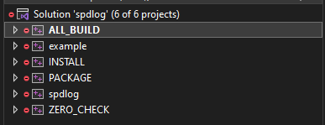
Installation of spdlog (Con't)
Set CMAKE_INSTALL_PREFIX to C:/dev/Library/spdlog then click Configure again.
Click generate then click Open Project.
Mouse right click on ALL_BUILD and click Build.
Mouse right click on INSTALL and click Build.
Add C:\dev\Library\spdlog to spdlog_DIR in system variable

Slide 17


Check Environmental Variables
Inside System variables
Inside Path
Alert! For CLIPPER2_DIR, must use /

Slide 18

Build SyNSlicerEnginer
Run cmd in C:\dev\Project
Run command git clone https://github.com/XUPENGDA-HKUST/SyNSlicerEngine.git
In C:\dev\Project\SyNSlicerEngine, create a new folder call “debug_build”
Set the paths and then click Configure twice and then click Generate and then click Open Project

Slide 19
Build SyNSlicerEngine (Con't)
Mouse right click on SyNSlicerGUI, click Set as Startup Project.
Click Local Windows Debugger.

